Slide 1

Blinkit Grocery Store Analysis
By Abhishek Joshi
College: Bharati Vidyapeeth Deemed University Department of Engineering and Technology

Slide 2

PROBLEM STATEMENT
Blinket, a leading online grocery store in the United States, operates a diverse range of outlets, varying in size and type. The company aims to provide a seamless shopping experience, offering a wide variety of products to meet the needs of its customers. Despite its success, Blinket faces several challenges in effectively analyzing its sales data to derive meaningful business insights. These insights are crucial for understanding performance, identifying trends, and making strategic decisions. The key challenges include:
Sales Disparities: There is a significant variation in sales performance across different product categories and sub-categories, as well as among different types and sizes of outlets.
Top-performing Products: Identifying which items are most popular among customers and driving most sales.
Underperforming Outlets: Recognizing outlets that are not meeting sales expectations and understanding the factors contributing to their underperformance.
Outlet Establishment: Tracking the number of new outlets established each year to analyze growth patterns and market penetration.

Slide 3
Project Description
Objective: The primary goal of this project is to leverage the sales data provided by Blinket to develop an interactive Power BI dashboard. This dashboard will offer comprehensive insights into various aspects of Blinket's business operations, facilitating informed decision-making and strategic planning. Some of the End Goals are:
Enhanced Sales Understanding:
Gaining a detailed understanding of sales performance across different product categories and outlet types.
Strategic Decision-making:
Utilizing data-driven insights to make informed decisions regarding inventory management, marketing strategies, and outlet operations.
Operational Efficiency:
Identifying opportunities to streamline operations and optimize resource allocation to enhance overall profitability.
Pain Points for Targeting Analysis:
Measuring Sales through Different Outlet Types:
Assessing sales performance across various outlet types (e.g., small, medium, large).
Identifying Top-selling Products:
Determining which items are most frequently purchased by customers to optimize inventory and marketing strategies.
Underperforming Outlets:
Identifying stores with low sales performance and analyzing the reasons behind their underperformance to implement corrective actions.
Tracking Outlet Establishment:
Monitoring the number of new outlets established each year to understand expansion trends and market growth.

Slide 4

WHO ARE THE END USERS?
The end users who this report will target are:
Primary Users:
Blinket’s Project Management Team and Product Management Team:
These are the top-level executives and decision-makers responsible for setting the strategic direction of the company. They will use the dashboard to gain high-level insights into overall business performance, identify key trends, and make informed strategic decisions to drive the company's growth and profitability.
Secondary Users:
Sales and Marketing Teams:
These teams will use the dashboard to track sales performance across different products and outlets, evaluate the effectiveness of marketing campaigns, and identify areas for improving sales strategies and customer engagement.
Store Managers and Regional Managers:
These users are responsible for the day-to-day operations of individual stores or regions. They will use the dashboard to monitor store performance, identify underperforming outlets, and implement targeted actions to enhance sales and operational efficiency.

Slide 5

Technology Used
Software:
Power BI for data visualization and dashboard creation.
Tools and Techniques:
Power Query for data cleaning and transformation.
DAX (Data Analysis Expressions) for creating measures and calculations.
Various Power BI visualization tools such as bar charts, donut charts, and funnel charts.

Slide 6
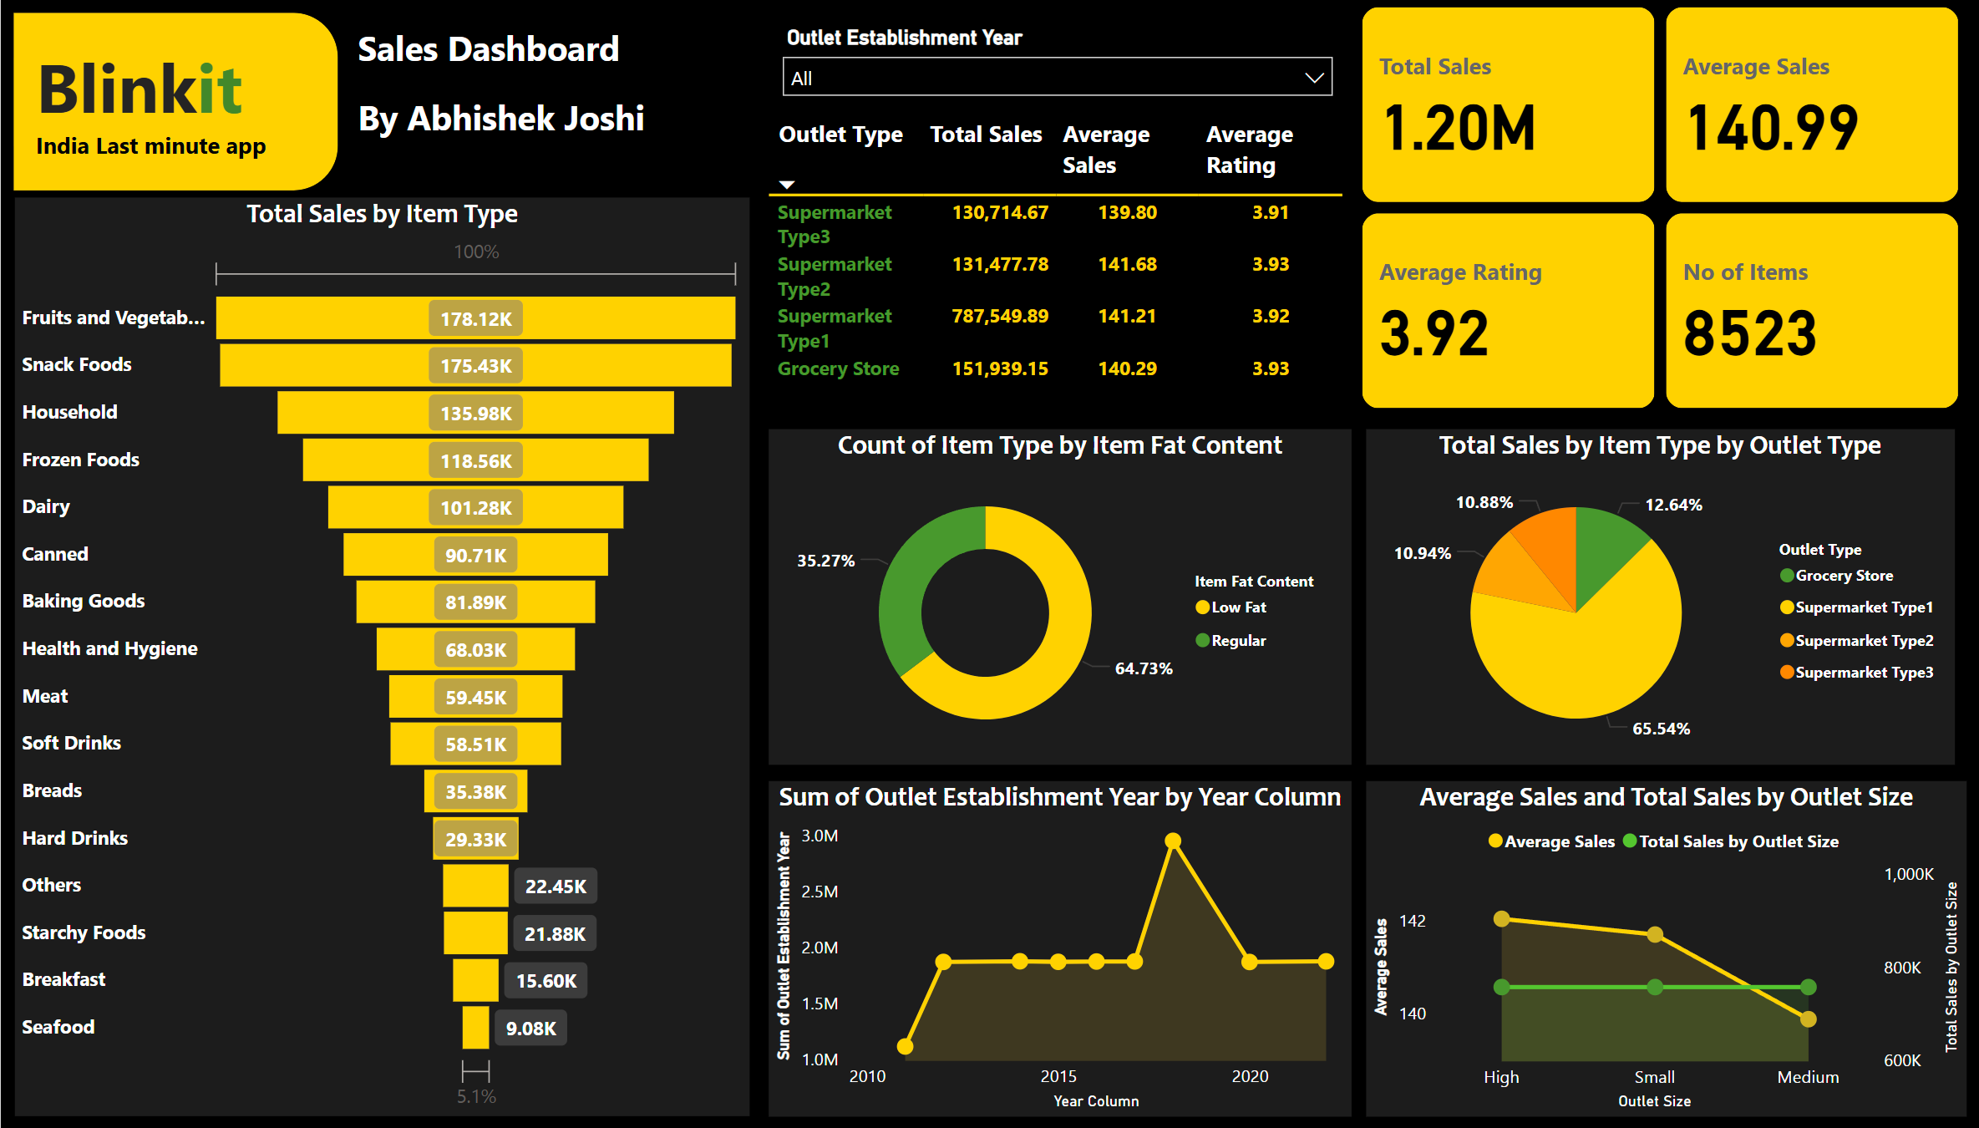
RESULTS
.
Final Power BI Dashboard

Slide 7
Additional Notes :
To access the Power BI, you can click on Google Drive link given below
Link :
https://drive.google.com/file/d/1LmLuyT33XJEjZZmZyrKsMjxQ84laQJ4d/view?usp=sharing
To access the Blinkit Dataset you can click on the link given down below
Link :
https://www.kaggle.com/datasets/mukeshgadri/blinkit-dataset
GitHub Repository Links :
https://github.com/Abhishek-joshi1/Blinkit-Grocery-Store-Analysis-
.

Slide 8
Thank you
.
.

